Slide 1
Tableau
Lab
Ezekiel Suarez
DAT 431

Slide 2
01
Exploring The Data

Slide 3
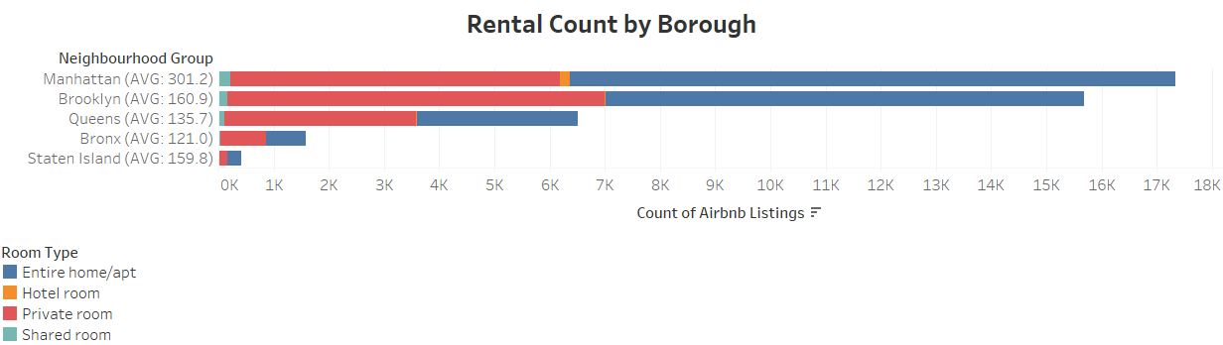
Manhattan has the most BNB rentals available, closely followed by Brooklyn. Hotels and Shared Rooms are not common on AirBNB and the room type is generally split evenly between Private Rooms and Entire Homes.

Slide 4
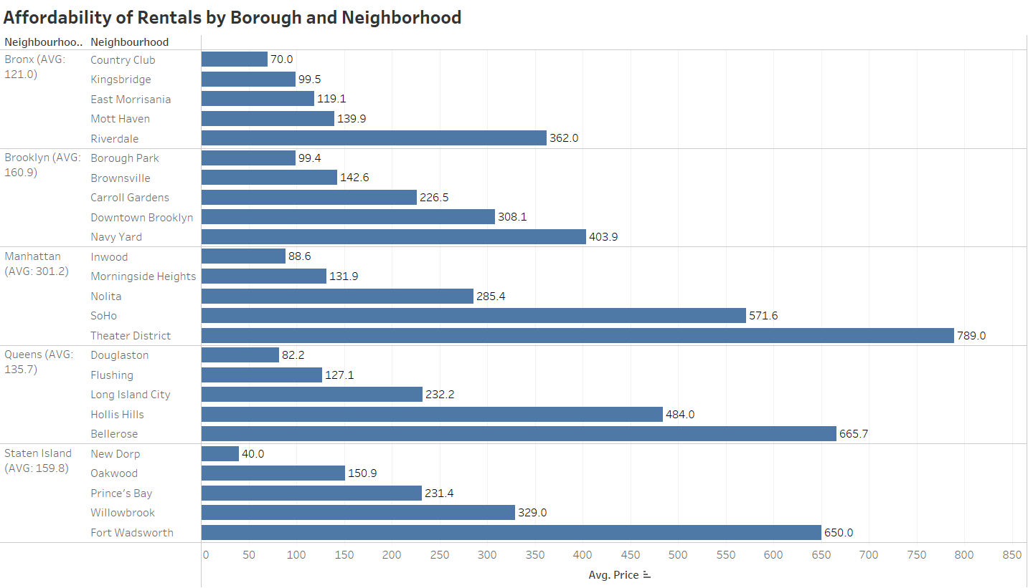
The average price to rent a night at a BNB is lowest in the Bronx, but each borough has more pricey or more affordable neighborhoods.

Slide 5
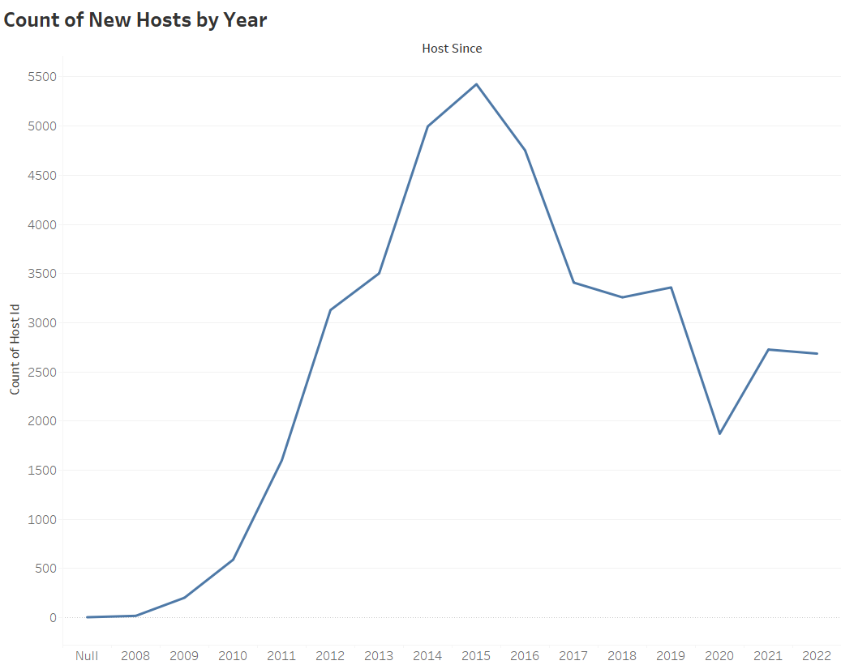
2015 saw the biggest jump in AirBNB hosts. Since then, the government has tried to limit BNB hosting to help the city’s economy.

Slide 6
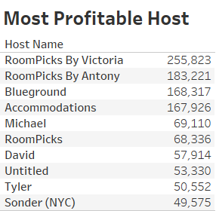
RoomPicks By Victoria has made the most money from AirBNB hosting, followed by RoomPicks By Antony and Blueground.

Slide 7
02
Case Study

Slide 8
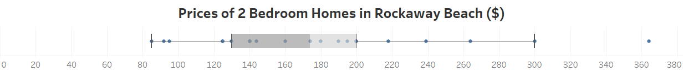
With her home in Rockaway Beach, Julie could easily get away with a nightly rental fee of $130 - $200. The average in her area is $179.

Slide 9
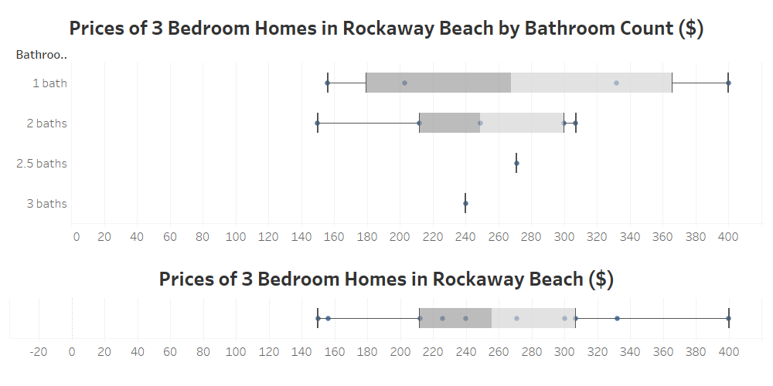
If Julie upgrades her home with an extra bedroom, she could charge a $215 - $305 per night where the average is $259. Bathrooms seem to have no effect on prices.

Slide 10
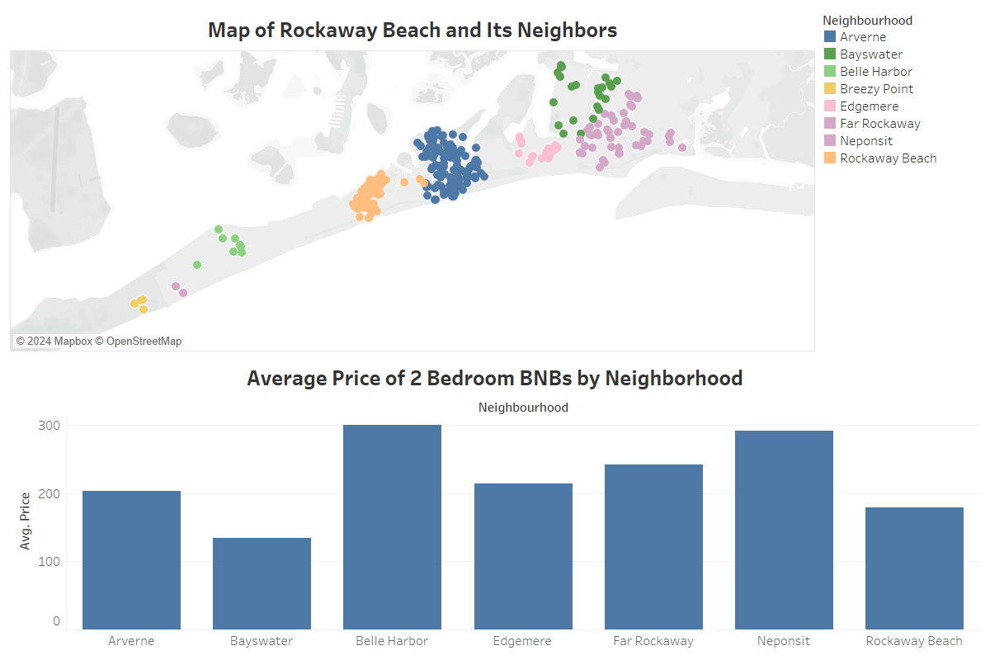
Rockaway Beach’s 2 bedroom options are cheaper than some of their neighbors. The biggest competing neighbourhood would be Arverne with many options of similar location and price ($204.1 on average).

Slide 11
If Julie wants to pay for this renovation by profits on her current home being rented, we can estimate it will take about 75 - 116 nights being rented out.
Charging maximum suggested: $15,000/$200 = 75
Charging minimum suggested: $15,000/$130 = 115.4
Charging neighbourhood average: $15,000/$179 = 83.8

